Slide 1

Ghost Energy Gum
Marketing Plan
Elle Walasavage, Jack Barr, Mya Morales, Luis Acosta

Slide 2
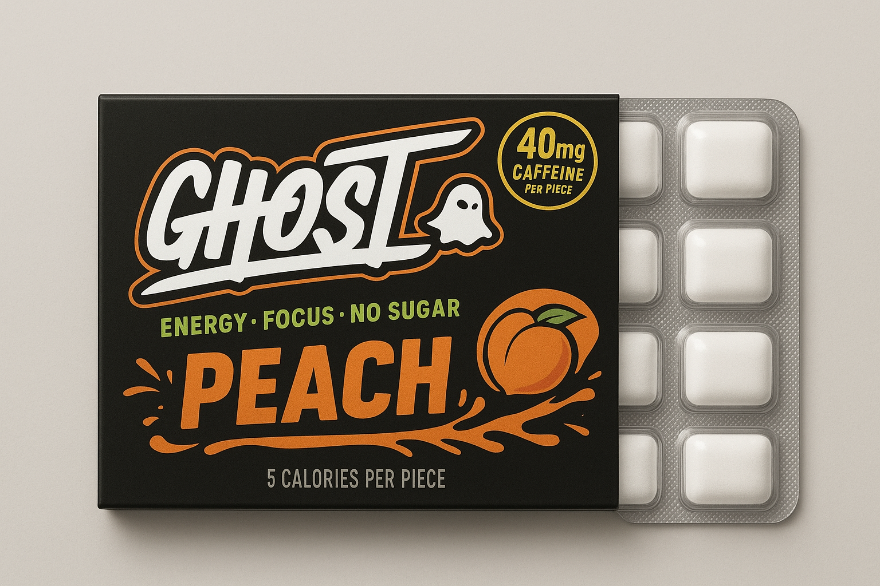
Product Overview
Ghost Energy Gum
  12 pieces per pack
  40 mg of caffeine
  $12 dollars per pack
  Portable form of on-the-go energy
    Quick activating caffeine delivery
    Zero sugar
    Variety of Ghost’s signature flavors
    Portable
    Easy to consume

Slide 3
Importance of Marketing
Strengths
Unique portfolio
Rising caffeine trends
Weaknesses
Lack of experience in gum production
Costly investment
Questions of alignment with brand
Trustworthiness
Strong online presence
Experience and partnerships

Slide 4
Importance of Marketing
Threats
Existing competitors
Opportunities
Growth in a niche market
Safe and effective caffeine levels
Gum regulations
Required production time
Potential to dominant
Caffeine trends on the rise

Slide 5
Marketing Research Approach
Identified demand for caffeinated alternatives
Reviewed market growth data
  Energy gum market projected to double ($125M to $250M) by 2034 (Pandey, n.d.)
Discuss target market
  Differentiated Marketing Strategy
  Consumer Analysis
    Qualitative Data
    Quantitative Data
  Competitor Analysis
    Create Comparison

Slide 6
Competitors
NeuroGum and Run Gum
  Both sell large bundles, few flavor options
  Price around $25 per pack
Run Gum: 100 mg caffeine, flavor fades quickly
NeuroGum: 40 mg caffeine, milder effect, no single packs
  Smallest NeuroGum option = 6-pack (54 pieces)
Ghost advantage: offers single packs for easy trial
Stronger brand reputation + better flavor variety
Ghost uses 40 mg caffeine with transparent ingredients
Ghost’s loyal consumer base supports strong promotion

Slide 7

Target Market and Segmentation
Primary Segments
  Demographics
  Environmental Factors
  Geographical
  Market Segmentation
  1. Measurable
  2. Actionable
  3. Differentiable
  4. Accessible
  5. Substantial

Slide 8
Product Life Cycle
Fast movement through cycle due to high energy-product demand
Quick intro + growth phases
Influenced by caffeine trends, Ghost’s reputation, competitor success, consumer interest
Marketing by Stage
Introduction: build awareness, drive trial (social media, influencers, partnerships)
Growth: strengthen loyalty, attract new buyers
Maturity: highlight benefits, seasonal deals, limited promotions
Decline: maintain sales with updates + refreshed promotions
Extending Product Life
New brand collaborations (ex: nostalgic flavors)
Nootropic/function-based versions
Limited-edition flavors to boost engagement

Slide 9
Positioning and Differentiation
Healthy, convenient, portable energy alternative
  Fast-activating with great flavors
  Trusted brand reputation
  Ideal for busy, on-the-go consumers
  More discreet than energy drinks or coffee
  Appeals to a broad audience, not just fitness users
  Expands Ghost’s presence in the lifestyle market

Slide 10
Market Trends
Energy gum market projected to double by 2034 (Pandey, n.d.)
Mint dominates, but Ghost’s flavors offer differentiation
Caffeine demand rising among students, athletes, professionals

Slide 11
Marketing Mix
Product
Price
Place
Promotion

Slide 12
Pricing Strategy
Value-based pricing: ~$12 per pack
Premium positioning vs. $4 gum and $25 bundles
Seasonal deals, bundles, loyalty rewards

Slide 13
Place
Available online (Ghost, Amazon) and in stores
Pop-ups at gyms, campuses
Influencer endorsements, seasonal flavors, free samples

Slide 14
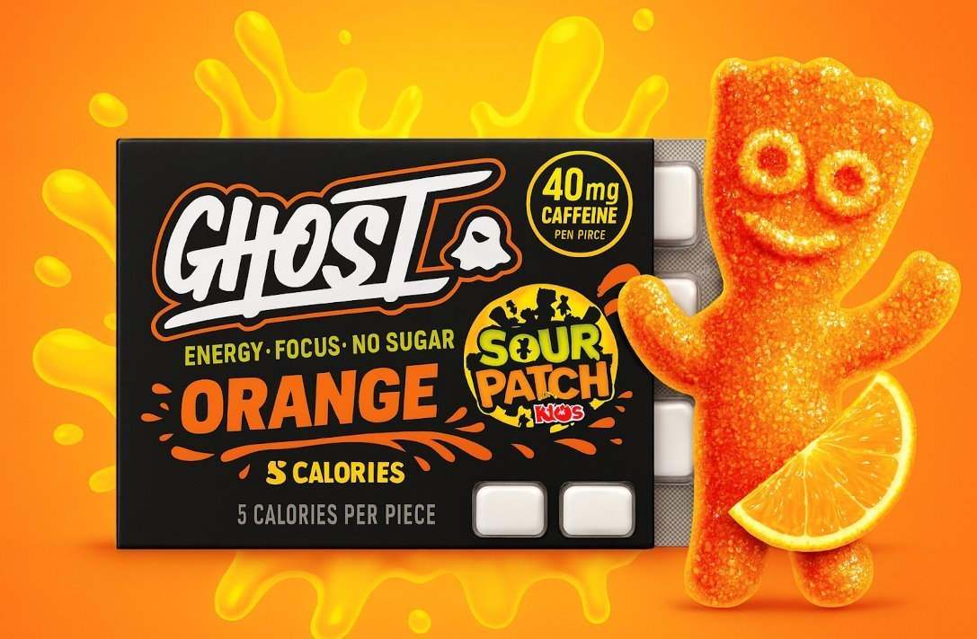
Sales Promotion
Beginning Approach:
Month 1: Teaser posts & giveaways
Month 2: Cross-promotions with drinks/apparel
Month 3: Student/athlete discounts
Month 4: Loyalty rewards, limited flavors
Advertising Plan:
Launch campaign on Instagram, TikTok, X, and YouTube
Use short-form videos to show real-life gum usage (studying, workouts, travel)
Partner with influencers and college ambassadors to build credibility
Track performance through sampling codes, engagement metrics, and ROI

Slide 15
Public Relations and Social Engagement
Public Relations Opportunities
Sponsor campus events, marathons, and local sports tournaments
Pop ups at universities and gyms
Continue collaborations
Appear on fitness podcasts, interviews, and social media posts
  These help to build trust beyond traditional ads
Social Engagement Strategy
Use polls, contests, and voting to boost engagement
Encourage fan-generated content and sharing.
Position gum as an everyday lifestyle product, not just fitness-related.
Create a fun, interactive online community that shows products realistic use

Slide 16
Channel Management and Distribution
Distribution Strategy:
Hybrid approach using Ghost’s website, Amazon, gyms, convenience stores, college shops, and existing retail partners for wide availability.
Cost Considerations:
Shipping and packaging for online orders, placement fees for retail stores, and commissions for gyms or specialty shops.
Placement Approach:
Positioning gum near checkout areas and beside energy drinks or protein snacks to encourage impulse buys and cross-link with Ghost’s lifestyle image.
Goal: Reach high-traffic, relevant locations while keeping distribution costs under control.

Slide 17
Budget
Global energy-gum market was valued at US $106.4 million in 2023 (Srivastava, 2024)
  Projected growth to $248.01 million by 2034
  Compound annual growth rate of 7.94% between 2025 and 2034. (Pandey, 2025)
Estimated launch budget: $30,000
Regular gum: $0.04 per piece
  Raw Ingredients: $12,000-$15,000
  Packaging: $8,000-$10,000
  Promotions, advertisements, endorsements
    KDP acquisition of Ghost plans to invest $250 million
  Aligns with Ghost’s current budget

Slide 18
Evaluation
Performance Metrics:
Sales revenue, units sold, and repeat-purchase rates will show whether the gum is gaining traction and meeting expected demand.
Website traffic, sampling conversions, and social media engagement help measure the success of online promotions and influencer partnerships.
Tracking the effectiveness of events, pop-ups, and collaborations will show which promotional activities drive the strongest consumer response.
Brand Impact:
The gum supports Ghost’s broader mission to be both an energy brand and a lifestyle brand by offering a portable, everyday product that fits naturally into busy routines.
By expanding beyond drinks and supplements, Ghost strengthens its position as a lifestyle company with products that can be used anywhere, not just in the gym.
The gum appeals to newer audiences such as students, professionals, and casual consumers who want fast energy without a full beverage, helping Ghost grow its reach beyond traditional fitness users.
Overall Goal:
Evaluate performance continuously so Ghost can adjust marketing strategies, introduce new flavors, and improve distribution to maximize long-term success.

Slide 19
References
Blackwell, N. (2025, September 1). The dialed blog. Dialed Gum. https://dialedgum.com/blogs/the-dialed-blog
Keurig Dr Pepper to acquire Disruptive Energy Drink Business Ghost. Media | Keurig Dr Pepper. (2024, October 24). https://news.keurigdrpepper.com/2024-10-24-Keurig-Dr-Pepper-to-Acquire-Disruptive-Energy-Drink-Business-GHOST
Pandey, D., & Shivarkar, A. (2025, January 16). Energy gum market size to hit USD 248.01 million by 2034. Precedence Research. https://www.precedenceresearch.com/energy-gum-market
Srivastava, S., & Prasad, E. (2024, August). Energy gum market size, share and industry analysis, 2035. Allied Market Research. https://www.alliedmarketresearch.com/energy-gum-market
Sushant. (2025, November 7). North America chewing gum market: A $6.07 billion future fueled by health, Flavor & Convenience. Feast. https://vocal.media/feast/north-america-chewing-gum-market-a-6-07-billion-future-fueled-by-health-flavor-and-convenience
Yang, C.-C., Hsieh, M.-H., Ho, C.-C., Chang, Y.-H., & Shiu, Y.-J. (2024, October 24). Effects of caffeinated chewing gum on exercise performance and physiological responses: A systematic review. Nutrients. https://pmc.ncbi.nlm.nih.gov/articles/PMC11547772/
Spiliakos, A. (2018, June 7). The sustainable art of chewing gum - HBS online. Harvard Business School Online. https://online.hbs.edu/blog/post/the-sustainable-art-of-chewing-gum

